Slide 1
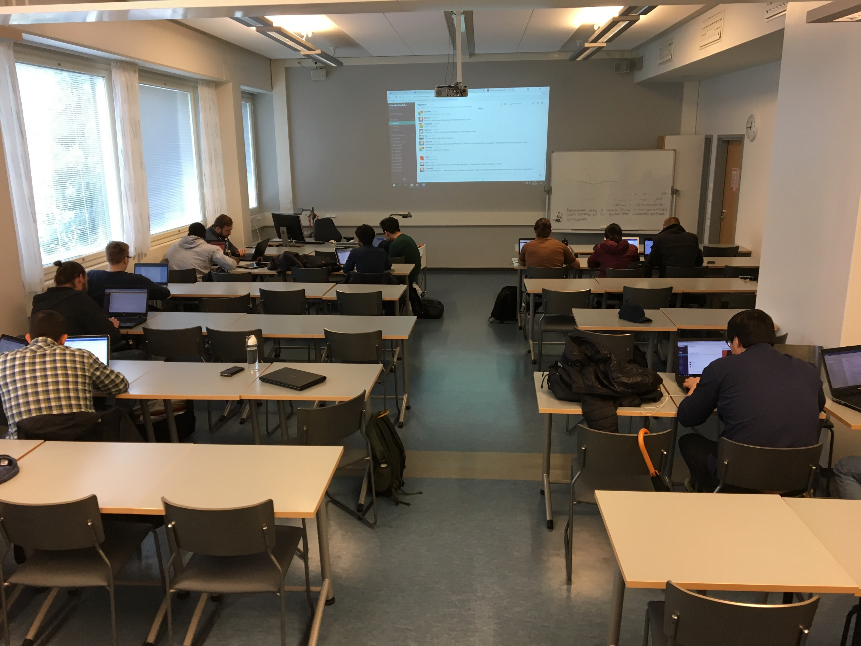



ID00B085 Developer Basic Skills
[ DevBasicSkills2017 – 8 ]
Project Work
18.12.2017
Kihun Han / DIN17SP

Slide 2
Before
General information about before project
Overall
Overall about how project is processed
Detail
Explanation about how implementation is processed

Slide 3
Before
Self-guideline, Process, Tools, Stakeholder’s requirements

Slide 4
Range
Within what I have learned so far
Diversity
Try to do differently for practicing
Usage
As possible as I can make it practical

Slide 5
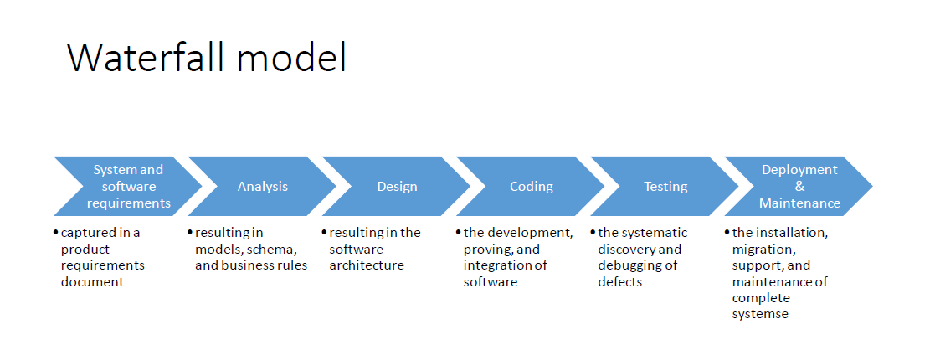

Slide 6

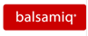





Visual Studio Code
Balsamiq
Microsoft Paint
Microsoft Project
Google Chrome
Mozilla Firefox
GitHub

Slide 7
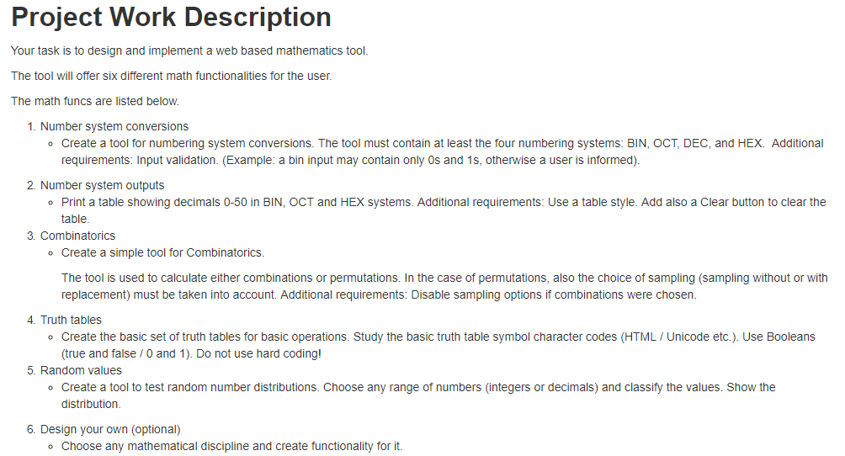

Slide 8
Overall
Basic User interface design, Coding, Test

Slide 9
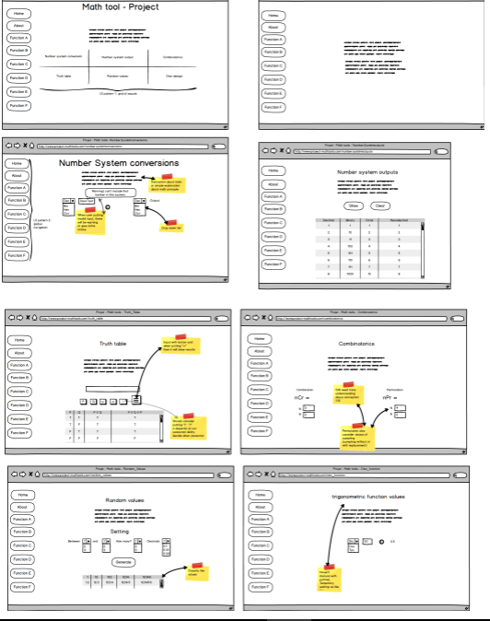

Slide 10
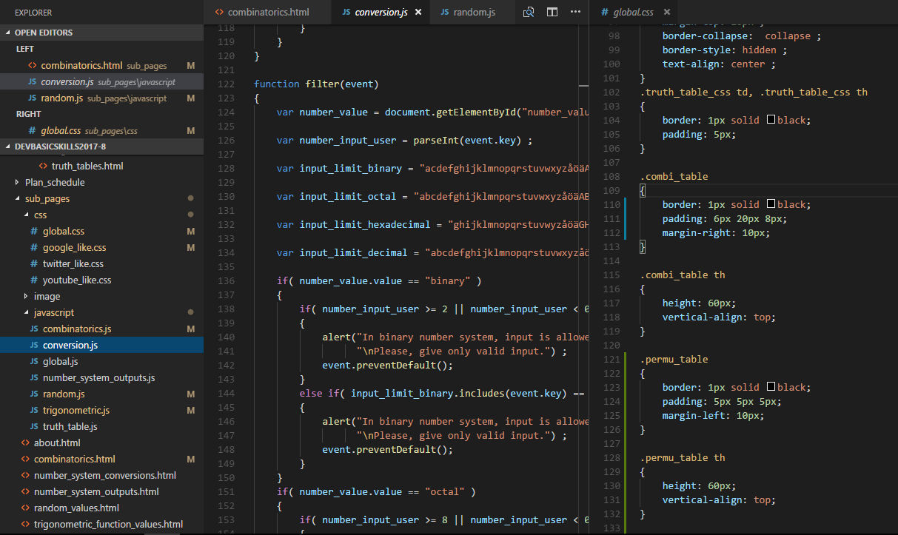

Slide 11
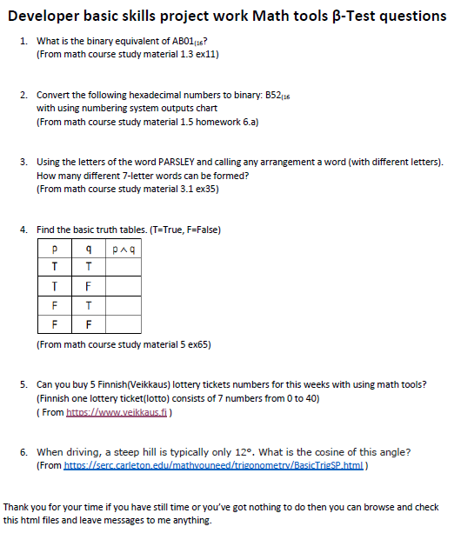
β-Test
Tester: Florian Brandsma, Jamie Burns, Olseksandr Gudenko
Date: 14.12.2017

Slide 12
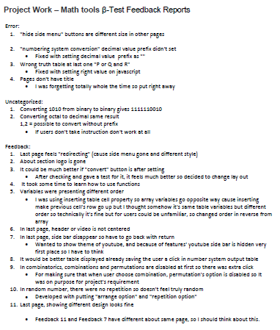

Slide 13
Detail
Basic Designs, Functionality of Tools, Coding, After Test

Slide 14
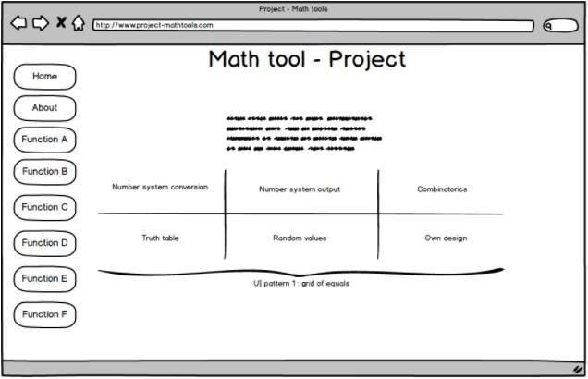

Slide 15
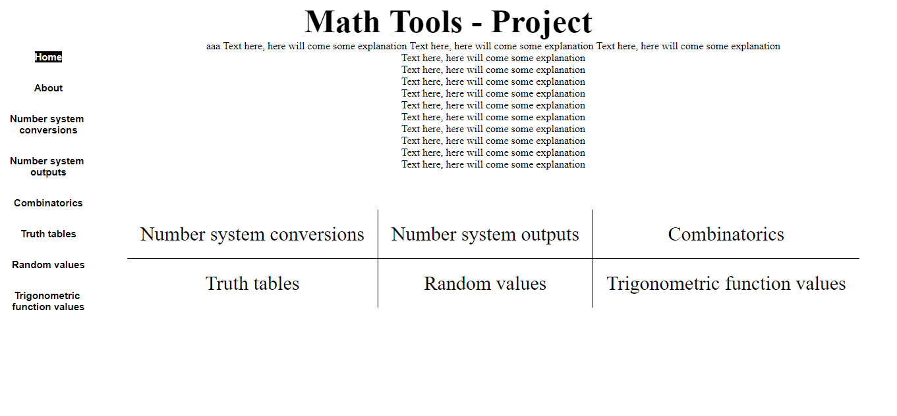

Slide 16
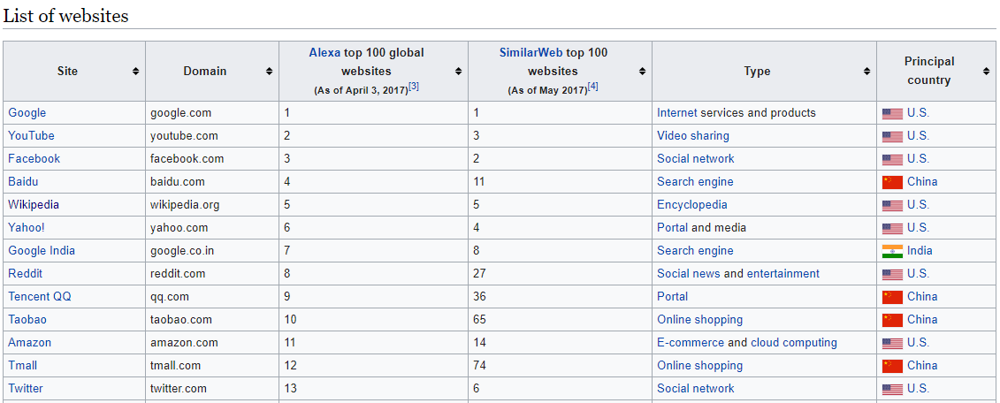

Slide 17
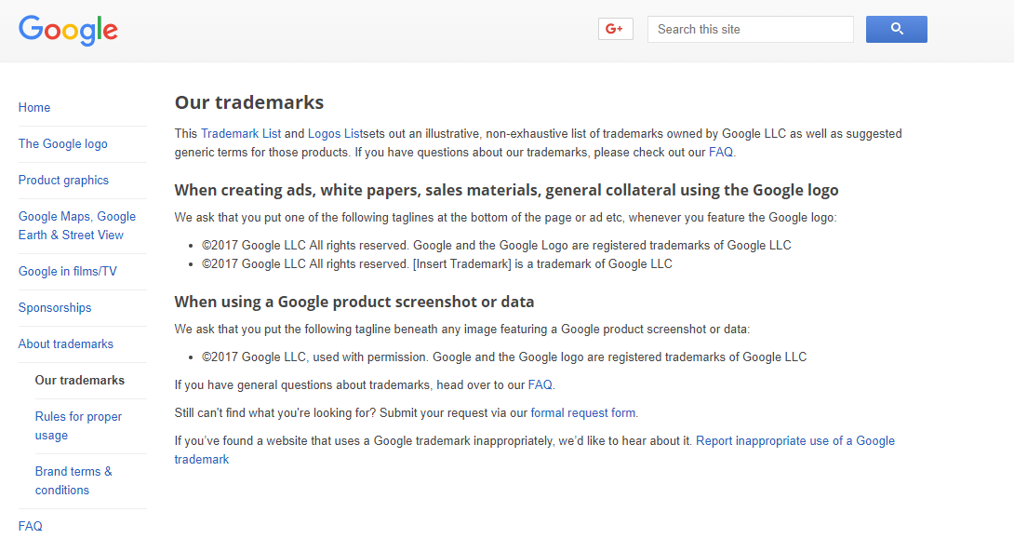

Slide 18
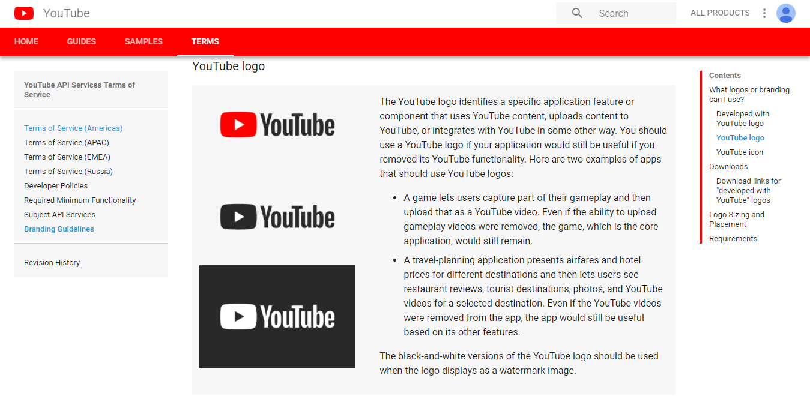

Slide 19
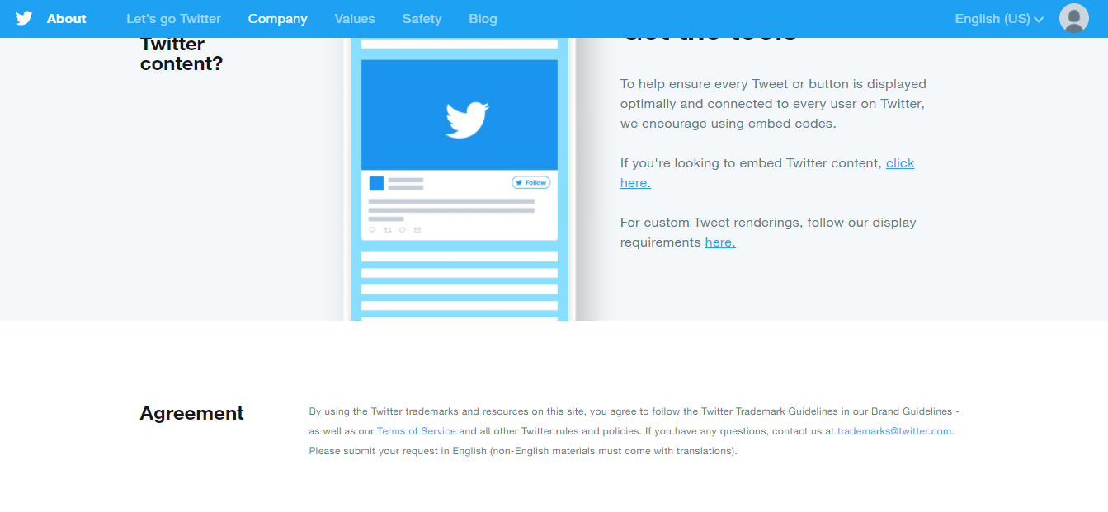

Slide 20
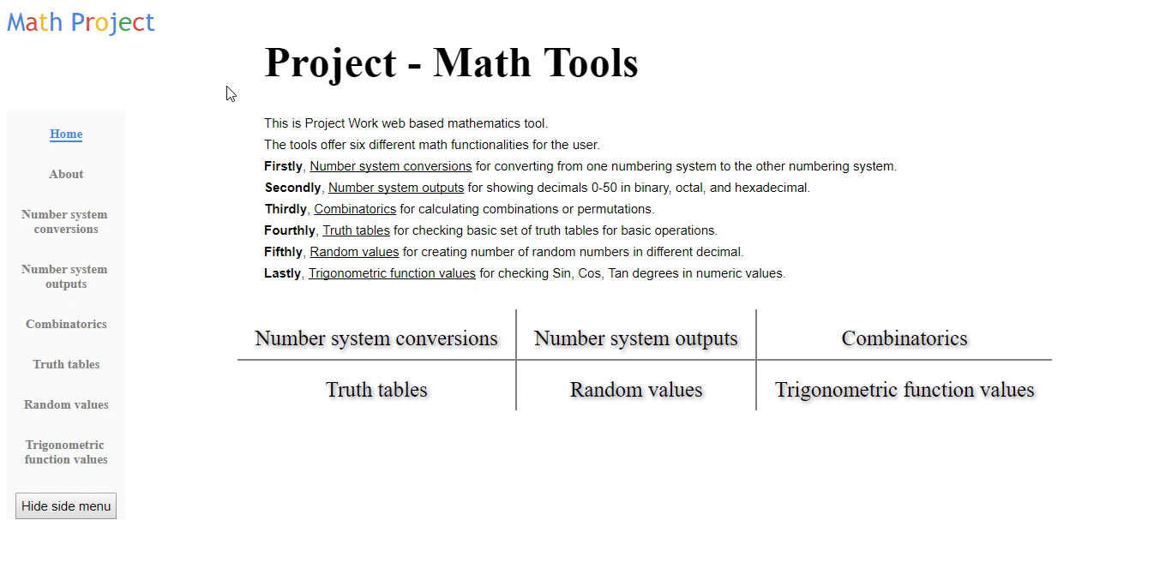

Slide 21
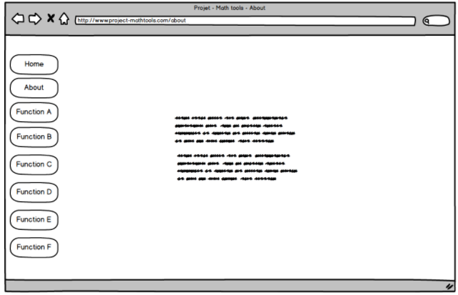

Slide 22


Slide 23
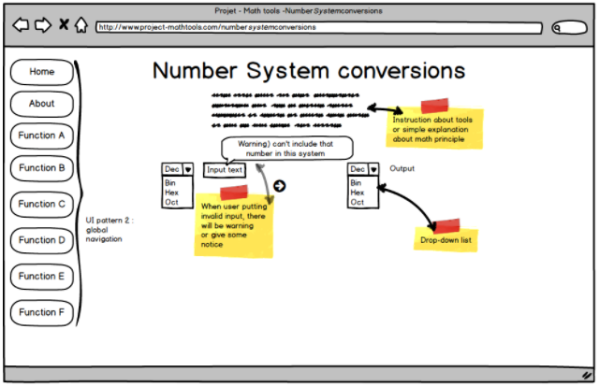
Create a tool for numbering system conversions. The tool must contain at least the four numbering systems: BIN, OCT, DEC, and HEX. Additional requirements: Input validation. (Example: a bin input may contain only 0s and 1s, otherwise a user is informed).

Slide 24
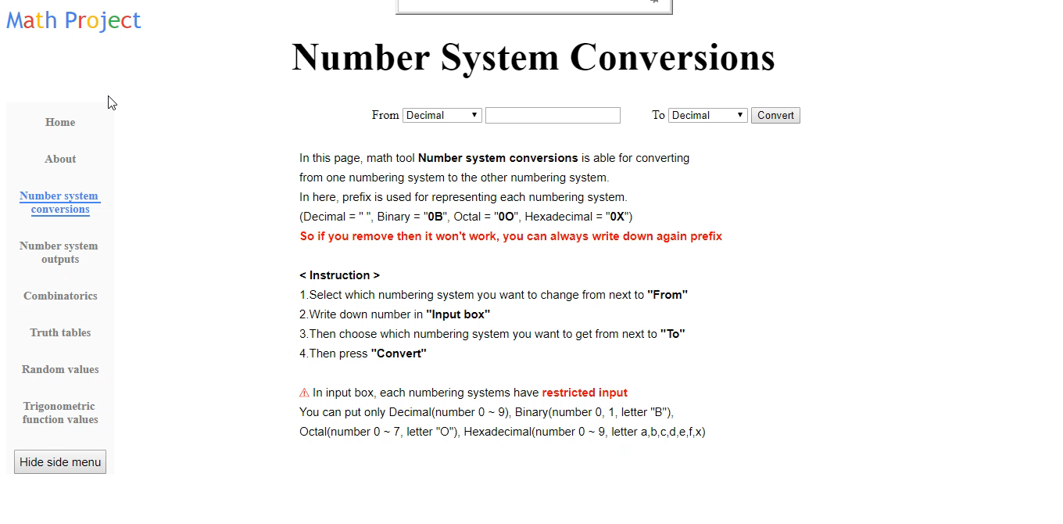

Slide 25
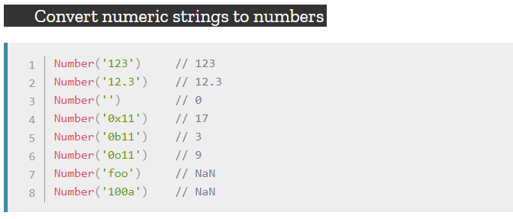

Slide 26
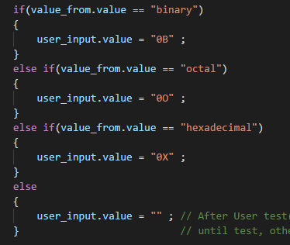
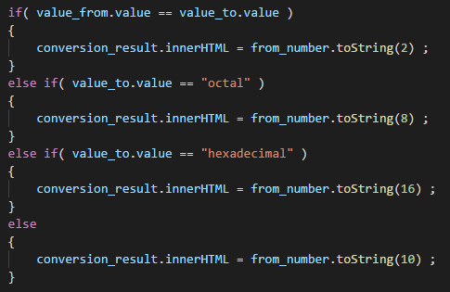

Slide 27
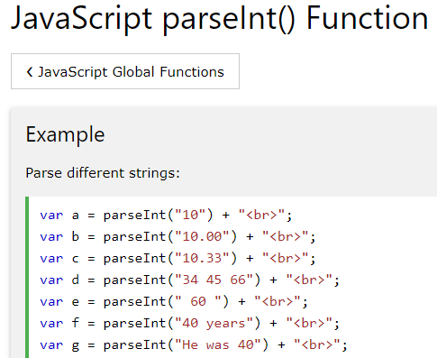
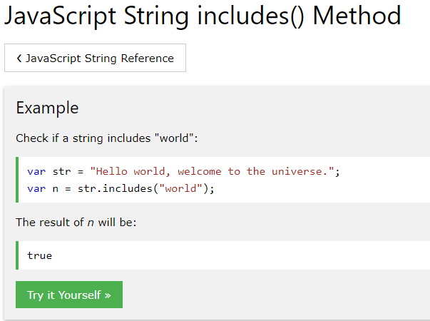

Slide 28
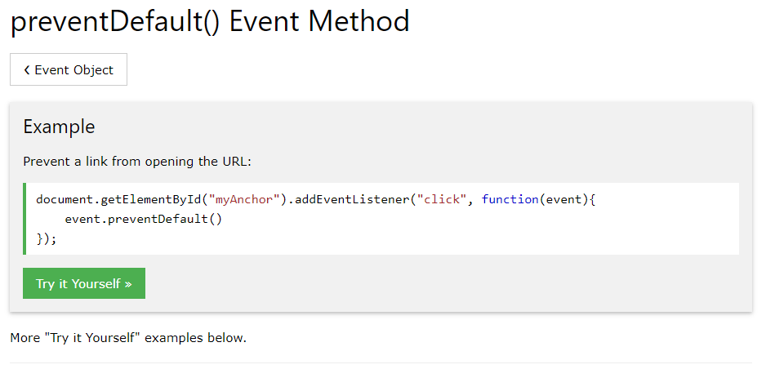
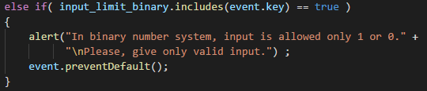

Slide 29
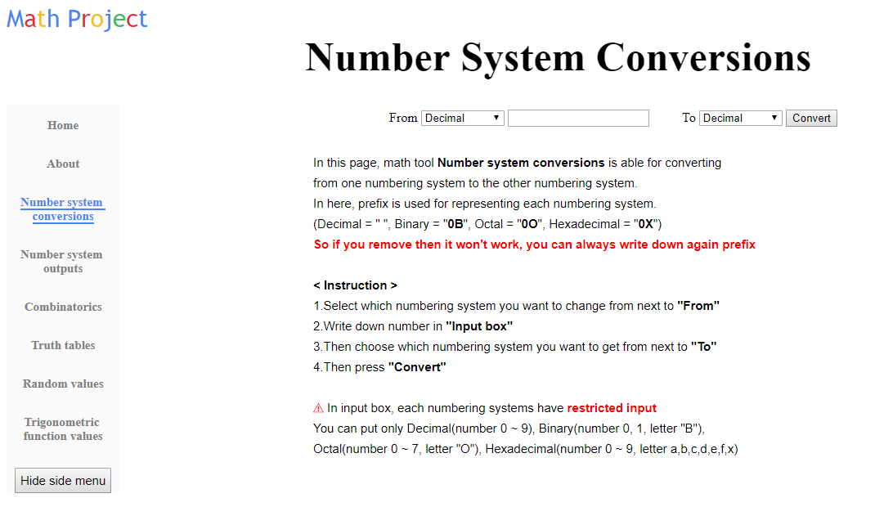

Slide 30
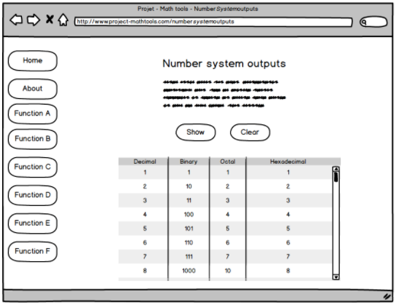
Print a table showing decimals 0-50 in BIN, OCT and HEX systems. Additional requirements: Use a table style. Add also a Clear button to clear the table.

Slide 31
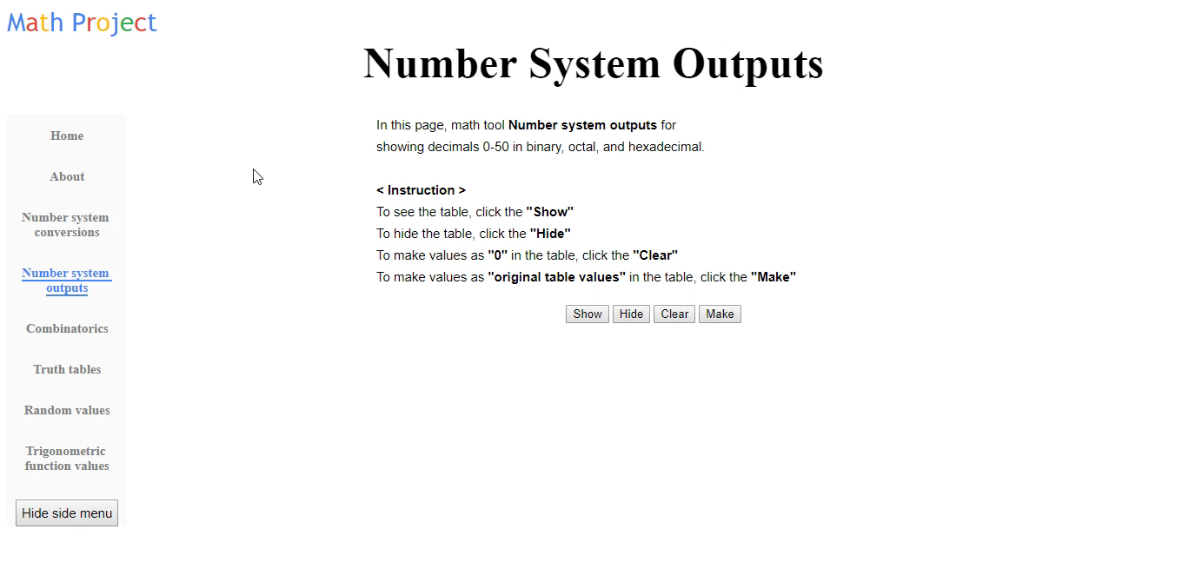

Slide 32
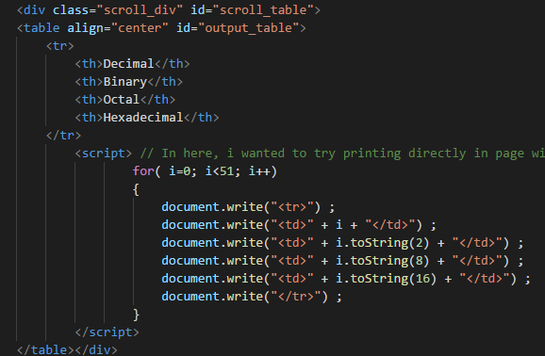

Slide 33
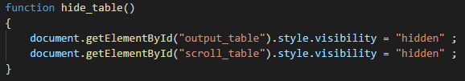
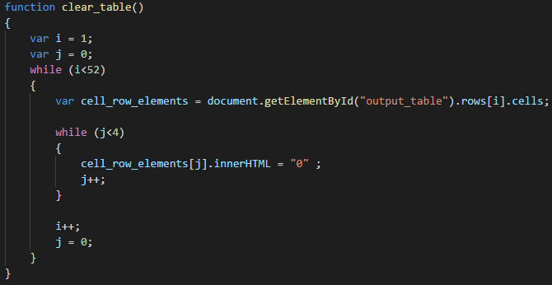

Slide 34
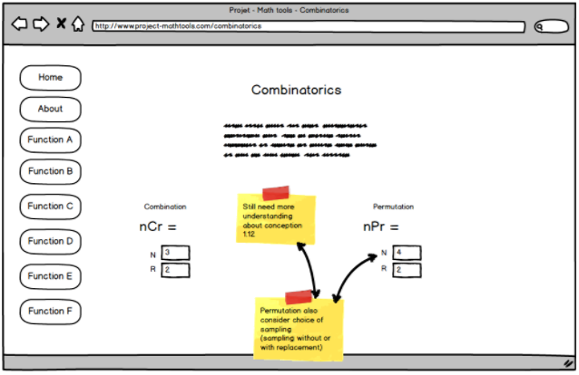
The tool is used to calculate either combinations or permutations. In the case of permutations,
also the choice of sampling (sampling without or with replacement) must be taken into account. Additional requirements: Disable sampling options if combinations were chosen.

Slide 35
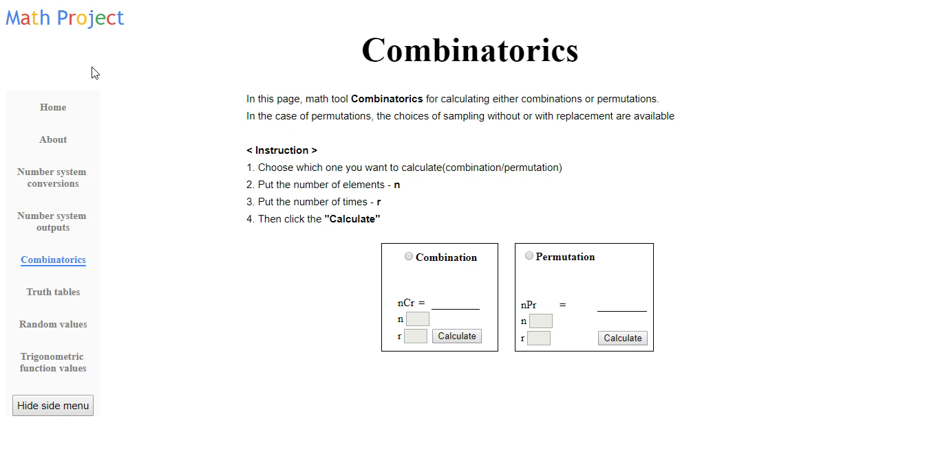

Slide 36
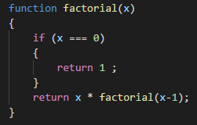
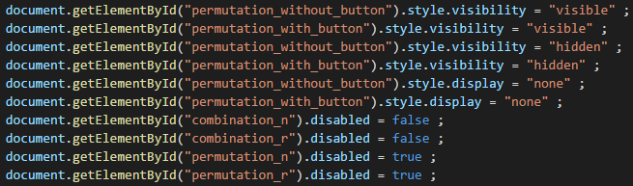

Slide 37


Slide 38
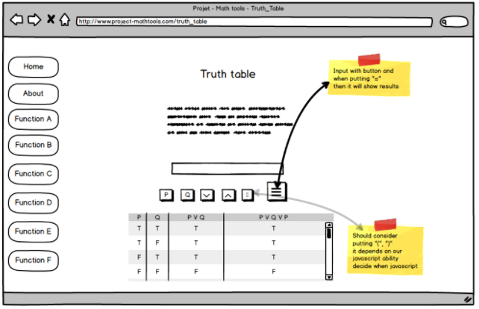
Create the basic set of truth tables for basic operations. Study the basic truth table symbol character codes (HTML / Unicode etc.). Use Booleans (true and false / 0 and 1). Do not use hard coding!

Slide 39
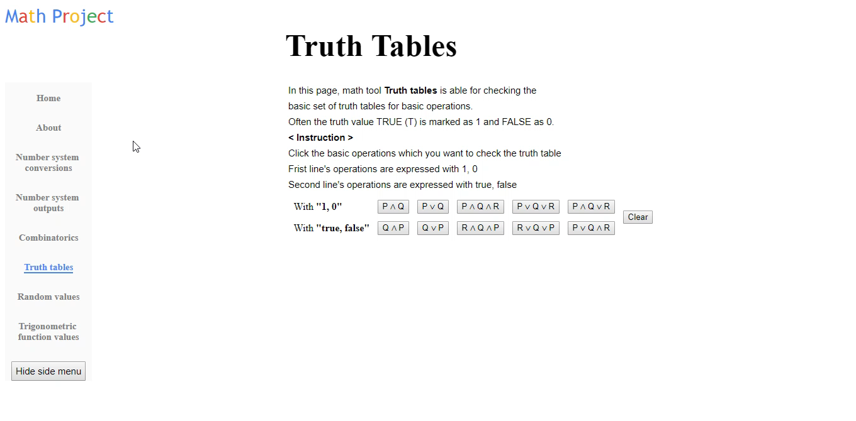

Slide 40
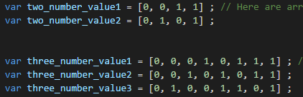
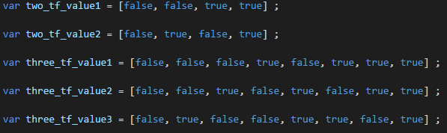
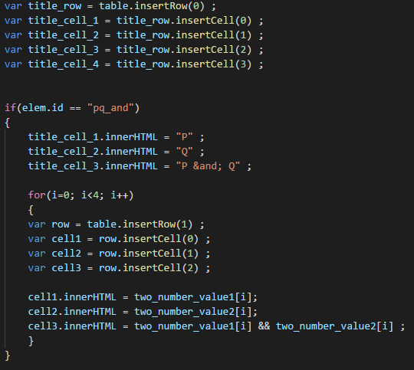
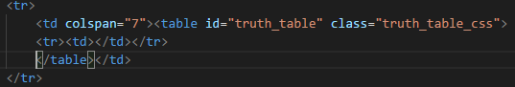

Slide 41
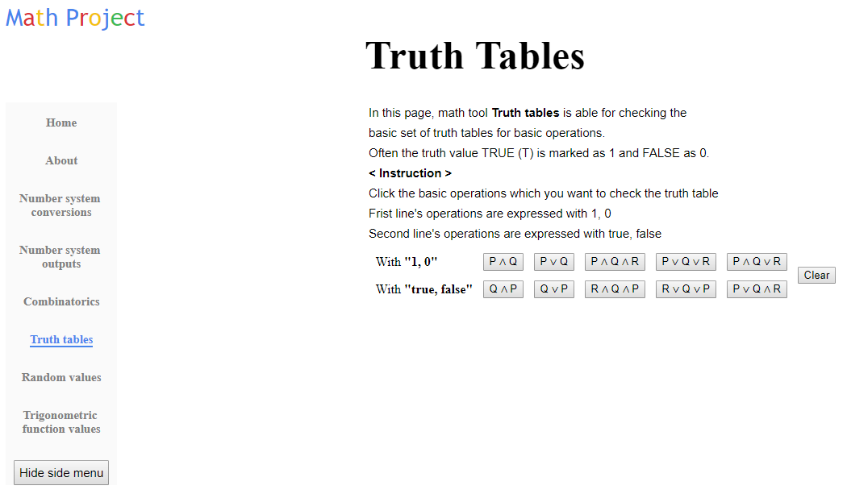

Slide 42
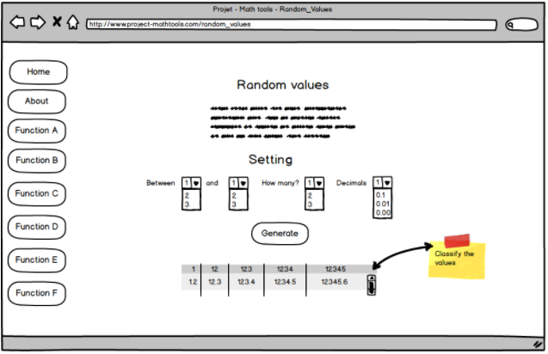
Create a tool to test random number distributions. Choose any range of numbers (integers or decimals) and classify the values. Show the distribution.

Slide 43
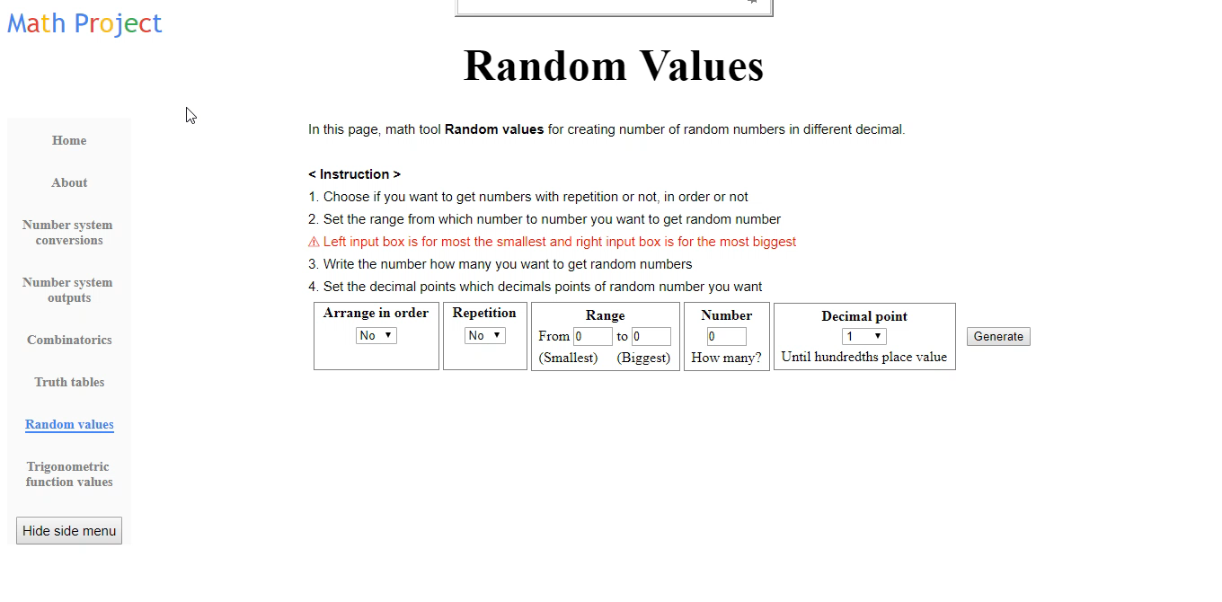

Slide 44
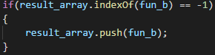

Slide 45
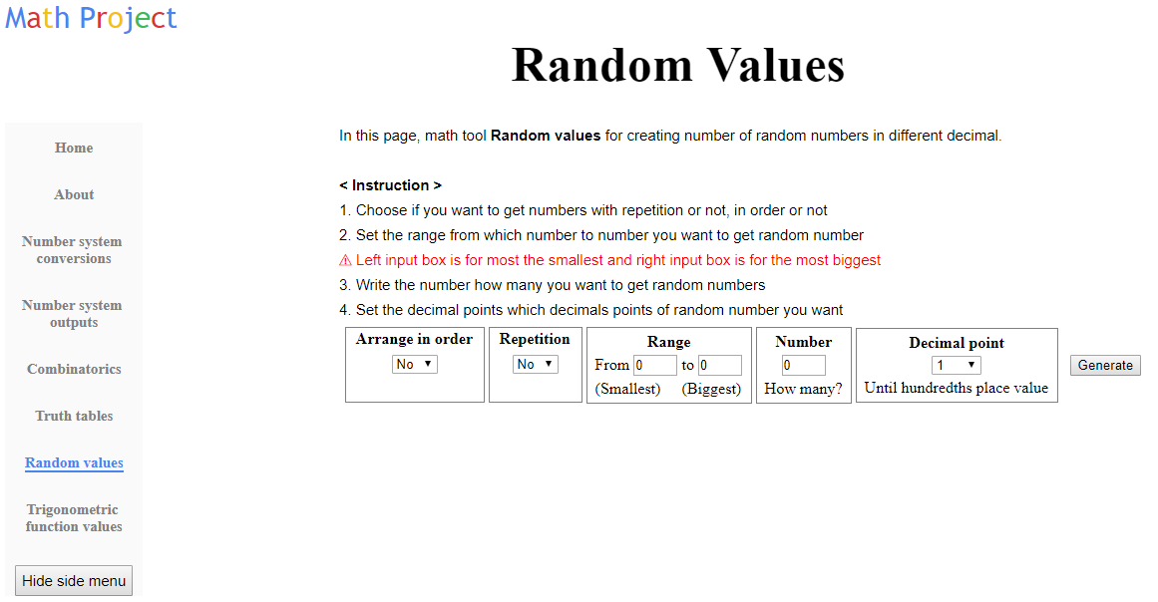

Slide 46
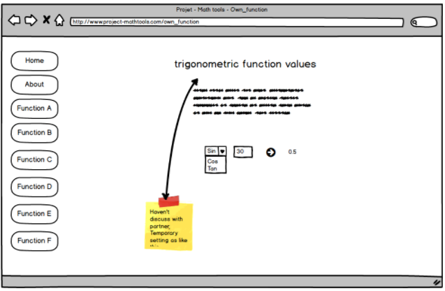
Choose any mathematical discipline and create functionality for it.

Slide 47
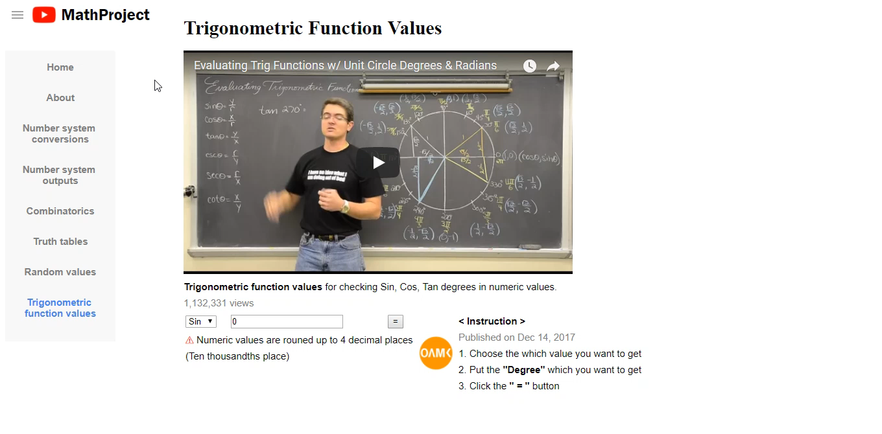

Slide 48
3.14159265358979323846264338327950288419716939937510 58209749445923078164062862089986280348253421170679 82148086513282306647093844609550582231725359408128 48111745028410270
193852110555964462294895493038196 44288109756659334461284756482337867831652712019091 45648566923460348610454326648213393607260249141273 724587006606315588174881520920962829
25409171536436 78925903600113305305488204665213841469519415116094 33057270365759591953092186117381932611793105118548 07446237996274956735188575272489122793818301194912 9833
6733624406566430860213949463952247371907021798 60943702770539217176293176752384674818467669405132 00056812714526356082778577134275778960917363717872 1468440901224953430146
5495853710507922796892589235 42019956112129021960864034418159813629774771309960 51870721134999999837297804995105973173281609631859 5024459455346908302642522308253344685035
2619311881 71010003137838752886587533208381420617177669147303 59825349042875546873115956286388235378759375195778 18577805321712268066130019278766111959092164201989

Slide 49
